Slide 1
Accessibility in digital world case finland
Pauliina Lampinen
Supporting Foundation for Children and Youth with Disabilites
pauliina.lampinen@vamlas.fi

Slide 2
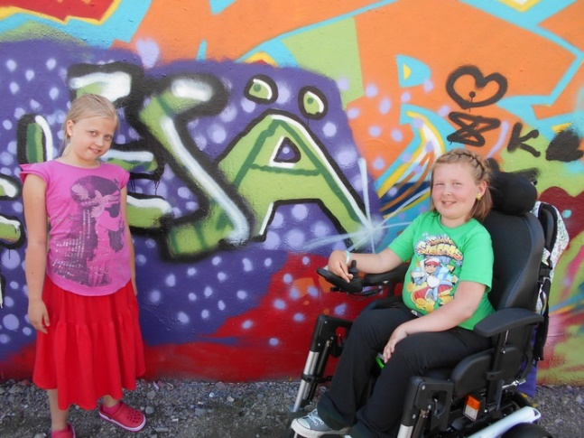
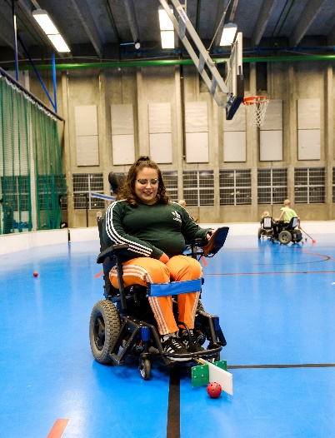
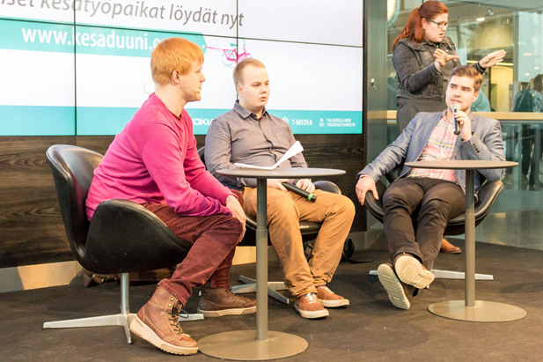
Vamlas today
Promoting equal opportunities, participation and human rights of children and youth with disabilities
Today Vamlas provides expert services, training and projects (employment, education, hobbies)
Inclusive housing services for students in Helsinki, Lauttasaari (Hoas)
Staff total of 30 people
Our goal:
Accessible services and right for participation
Education and paid work for all
’The way I want’ living and assistance
www.vamlas.fi

Slide 3
Directive (EU) 2016/2102
On the accessibility of the websites and mobile applications of public sector bodies (incl. some associations)
Websites published after 23.9.2018 accessible by 23.9.2019
Mobile applications accessible by 23.6.2021
Information and advice and training:
https://www.saavutettavuusvaatimukset.fi/

Slide 4
Guidelines for accessibility of websites
Perceivable - Information and user interface components must be presentable to users in ways they can perceive.
This means that users must be able to perceive the information being presented (it can't be invisible to all of their senses)
Operable - User interface components and navigation must be operable.
This means that users must be able to operate the interface (the interface cannot require interaction that a user cannot perform)
Understandable - Information and the operation of user interface must be understandable.
This means that users must be able to understand the information as well as the operation of the user interface (the content or operation cannot be beyond their understanding)
Robust - Content must be robust enough that it can be interpreted reliably by a wide variety of user agents, including assistive technologies.
This means that users must be able to access the content as technologies advance (as technologies and user agents evolve, the content should remain accessible)
If any of these are not true, users with disabilities will not be able to use the Web.

Slide 5
Case Finland
1 mil. People exclusive from digital services; heterogenius group: elderly, disabled, people with low reading and writing skills…
Difficult to find skillful web desingers
Constantly changing technology a challenge; how to keep up?
Need to develop design for all strategy.
Case Australia: https://www.youtube.com/watch?v=bEM9Fn9aOG8

