Slide 1
Transition from school to work - policies and practices
Pauliina Lampinen
Supporting Foundation for Children and Youth with Disabilites
pauliina.lampinen@vamlas.fi

Slide 2
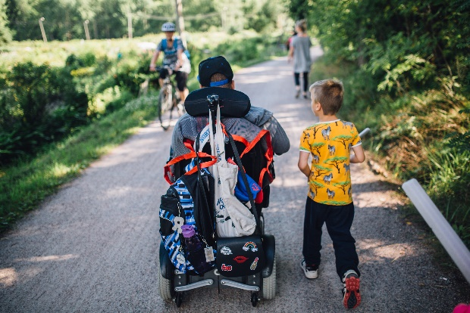
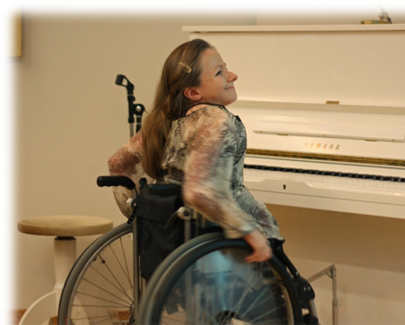
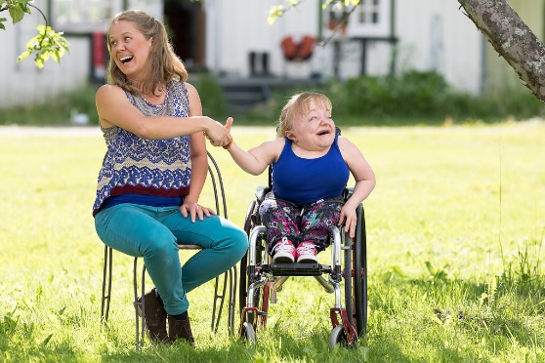
Shortly about Vamlas
Supporting Foundation for youth and children with disabilities
Founded in 1889 to promote education and employment of children and youth with disabilities
Today Vamlas provides expert services, training and projects (employment, services, participation)
Housing services for students in Helsinki, Lauttasaari (Hoas)
Staff total of 27 people
www.vamlas.fi

Slide 3
If we want employment to work we need to start with the schools
Early childhood care
Pre school and basic education
2nd education
Working life
Children without special needs
Special Employment
Children with special needs
We provide support, but separate from the mainstream, this tends to take those with special needs further from the mainstream working life
Notes:
The situation with the school system is similar in many other countries. Especially in Europe, the discourse of inclusion is strong, but the practises and the outcome of those practises are not so well known. Special needs require special support, that is clear, but it should lead to inclusive working life, not segregation.
This is why inclusion and learning the way inclusion should work in different situations is important.
In this picture you can see that children with special needs are more integrated when they are young. Many studeis support this in Finland; even in basic education grades 1-6 provice more opportunities to inclusion than grades 7-9.
When in secondary education, the pathways of those who have received spesial support separates from those who have studied with the mainstream.
And when we look at the working life those with special needs have drifted away from mainstream employment into special employment.

Slide 4
Do we get the same opportunities in learning?
Children with special needs face more lonliness and bullying (School health survey, 2017)
Children with disabilities feel left out due to lack of assistance and assistive devices (participation for hobbies for example)
Those given special ed in segregated settings feel they have not learned enough, or as much as others, when moving to mainstream education
32% of vocational education students (in mainstream schools) who have support needs, feels that they did not receive enough support.
Modern schooling requires competences in self steering and independence. Studies show that current pedagogy strenghtens mostly those student’s skills that already have these skills. And pedagogy fails to support those who have most needs.
Lack of working experience during studies makes it even more difficult to find employment after studies.
Notes:
If you are not given the opportunity, how do you learn the competences of an employee?
Children with disabilities experience more bulling and lonliness that other children. What is important is that this is the case even in special schools, so segregation does not automatically mean no bullying.
Children and youth with disabilities face lonliness. This is a very big issue! One problem is that special classess and schools tend to situate far away from the child’s home. The natural friendship with children in the neibourghood does not emerge and is not supported.

Slide 5
What is needed in education in order to promote transition to working life?
Attitude change: All children have the right to grow up as employees not only service users
Skills to develop mainstream education to become more inclusive
  Skills in diversity management
  Skills in pedagogics
  Skills in co-operation with the working life (work trials, on-the-job-training, metoring programmes etc.)
  Teachers’ competence building
  Innovative approaches
Accessibility; physical, mental, digital, communicational
Focus on school as a society, not only on individuals who have needs
Notes:
We cannot solve this problem by solely focusing on special schools and individuals who have special needs. We need to change the environment so the whole culture of the schools supports inclusion and learning of all students.
We cannot implement inclusion without resources and skills and support. When a child with special needs is just dropped into a mainstream class room without sufficient help it is not inclusion it is abandoment.
Inclusion is necessary if we want to prepare all children at all levels to cope with diversity in working life. Working life is already diverse, we need skills to cope and understand people with different backgrounds, different ways of working and communicating. Disability is one form of diversity.
We need accessibility. Especially in the digitalized world. We need to take care that digitalisation is a possibility for people with disabilities not a threat.
We cannot solve indlusion by focusing on the child’s needs, we have to look at the suffoundings, the class room and taaching as a society. The ways the community work is crucial. Improving the child’s skills is not eneough.

Slide 6
Inclusion in the labour market
Difficult to gain proper statistics
  Who is with a disability?
  Registered as work force or outside work force (retirement)?
  Registered as unemployed/employed/active in employment or social measures?
Disability is a problem if you are outside the labour force
Many people with disabilities who are working are managing fine, when given the right services and support
3 main policies in EU:
  Mainstreaming (same services for all)
  Special and separate employment (sheltered workshops or similar segregated labour market system)
  Dual and multimodel service system
          The Labour Market Situation of People with Disabilities in EU25 (Shima, Zólyomi, Asghar , 2008)
Notes:
How inclusive is the working life? Not very. This is clear even though it is difficult to gain proper statistics of the phenonemon. What we do know, is than once in employment people with disabilities manage fine, when given the right services and support.

Slide 7
Various measures for inclusion
Quota system:
  Austria, Czech Rep, France, Germany, Greece, Hungary, Italy, Lithuania, Luxemburg, Malta, Netherlands, Poland, Portugal, Slovakia, Spain
Partial quota:
  Belgium, Cyprus, Ireland, Slovenia
No quota:
  Finland, Sweden, Denmark, Latvia, Estonia, UK
Quota does not seem to work on its own, but needs other measures to support employment.
(Peer review: *Work capacity assessment and employment of people with disabilities’ Synthesis Report 2018)
Notes:
Different European countries have developed various systems to include pwds in to open labour market. One that we discuss a lot is the quota system.
Recent study in 12 different EU countries showed, that qouta is not the only and not even always the most effective way to include pwd in to open labour market. It seems to support those who are already in work contracts not really those, who are trying to enter the open labour market. Quota works best in public sector, but more differentiation should be in place when the quota is implemented in the private sector.

Slide 8
Incentives for employers
Wage subsidies
  Flex-security (DEN)
Penalty fees if not implementing quota
Financial incentives imbedded in vocational rehabilitation services
  In Finland large employers benefit from rehabilitation more than early retirement activities
  Part-time sick-leave and part-time pensions
Various systems for internships, try-outs and in the job training
  Usually no wage costs for the employer, but costs for the insurance or public employment authorities

Slide 9
Special employment services, based on the status
Sheltered employment/workshops
  Increase in 2000 to 2008 in Austria, Germany, Finland, italy, Luxemburg and Portugal
  Decrease only in Poland and Sweden
  Social benefit/activity allowance (disability benefits, pension/rehabilitation benefits etc.)
Workshops and other special employment units common in all member states
  Not only for pwd, also other long-term unemployed people, young people, people with drug problems, people with immigrant background etc.
  Unemployment benefits and various models of financial support

Slide 10
Inclusive employment measures, based on the need
Supported employment methodology
  Place-train-maintain –model (also Individual Placement Support IPS) to open labour market with a help of a trainded job coach
  Used in many member states, but in various ways (not always towards open labour market, not always a permanent support, or permanent funding)
Supported Apprentiship –learning and getting a degree in the job
Employer focused job-coaching model
  RATKO –model: Training the work place, adjusting job tasks, profiling job demands and employee’s skills (IMBA, Melba)

Slide 11
Does inclusion work?
In education equality of opportunities and inclusion promote equality in transition stages, better secondary and higher education and better employability
In labour market inclusion results better economy both for the state and for the individual
Diversity management to support inclusion benefits all (employees, employers, society)

Slide 12
What is needed?
National strategies combining different policies and services towards a common end:
  Disability
  Employment
  Social security
  Rehabilitation
  Educational
Recognition of people’s skills and capacities not only incapacities
Benefits to promote working not staying outside work force
Awarness raising
Dissemination of good practises

Slide 13
Luxemburg recommentadions 2015
Everything about us, with us
  concerns young learners’ direct involvement in all decision-making concerning them
Barrier-free schools
  relates to the elimination of all physical and technical barriers
Breaking down stereotypes
  is all about the concept of ‘normality’. If we accept that everybody is different, then who is ‘normal’?
Diversity is the mix, inclusion is what makes the mix work
Becoming full citizens
Notes:
In preparation for the event, the 72 young participants received a document with the main outcomes of the three previous Hearings, as well as some questions for reflection and discussion in their respective schools.
The questions for discussion referred to ways in which their schools support them in their education, examples of how teachers and classmates take their needs into account, accessibility, class organisation and suggestions for ways to overcome remaining barriers to inclusion.
During the Hearing, the young learners, divided into six workshops, had the opportunity to further discuss these key issues and questions, share their own personal experiences and also convey their peers’ messages.
The main outcomes of the workshop discussions were presented in the plenary session, in the form of key messages, and were the basis for formulating the Luxembourg Recommendations

Slide 14
RI Guidelines from school to work
1. Children with disabilities and their parents are provided with sufficient support and help
2. Day-care and primary school staff, teachers and support workers have knowledge and skills to work with children with disability
3. Right for secondary education and support for transition from primary education onwards
4. Personal support should be provided for finding and keeping employment
5. Careful skills mapping and Individualized support
6. Co-operation between different stakeholders
7. Attention to teacher training and skills of support workers

Slide 15
reasonable accomodation
Quota, etc.
Labour market and paid work
’Segregation’
Special Employment
Higher education
Bachelor’s degree and Master’s degree
’Integration’
reasonable accomodation
’Segregation’
Special Education
Vocational Schools
Secondary education
General or vocational
’Integration’
Special pedagogy, accomodation
Basic Education
Starts at 5-7 yrs lasts until 16-18 yrs
Comprehensive schools
’Integration’
Special education classes
Special curriculum
’Segregation’
Special
Education
Schools
Pre-primary education 5-6 yrs in most European countries
Early childhood education and care
All Nordic Countries

